Slide 1
PassionHub
Connect with like minds, fuel your passion
Notes:
PassionHub is an interactive web application designed for individuals eager to connect with like-minded enthusiasts. Upon creating an account, users can personalize their experience by selecting areas of interest, which unlocks a world of tailored recommendations. Here the user Dive into vibrant passion groups, where dynamic discussions unfold through comments and reactions with upvoting features. Further users can foster meaningful connections, and use initial credits to access exclusive content and interactions. With a seamless React-based design, you easily navigate, discover new groups, and contribute to conversations that align with your passions. Join PassionHub today to explore, connect, and turn your interests into vibrant conversations.

Slide 2
The Team
Niraj Komalkant Malpani
Palaniselvam Shyam Sundar
Sahil Amol Mutha
Prashanth Baskar

Slide 3
About PassionHub
A social-media app connecting people having same passion
Gamified the social media app to engage customers on platform and thereby earn badges and credits
More you post, more you engage, more you earn!!
Create groups, join existing groups and follow your passion!!

Slide 4
01
Tech stack
Technologies used in development

Slide 5



TECH STACK
Frontend
ReactJS, Redux
Backend
Express.js, Node.js
Database
MongoDB

Slide 6
02
Key Features
Main features of the application

Slide 7
Key Features
User registration
User login
Creating group
Join group
creation of account
ability to login after creation of account
Users can create Passion Groups both paid and free
Users can join groups that are free or paid using credits that they have earned

Slide 8
Key Features
Create posts to group
Add Comments
React to posts
Ability to create post in the group after joining
Add comments to posts in the group
Dive into vibrant passion groups, where dynamic discussions unfold with upvoting options

Slide 9
03
Application demo

Slide 10

LOGIN PAGE
Login Screen

Slide 11

Register Screen

Slide 12
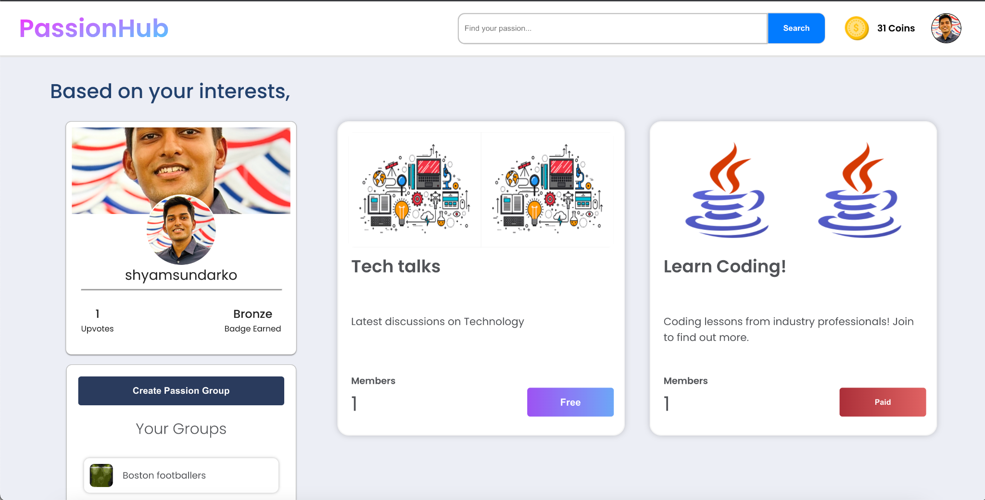
Home Screen

Slide 13
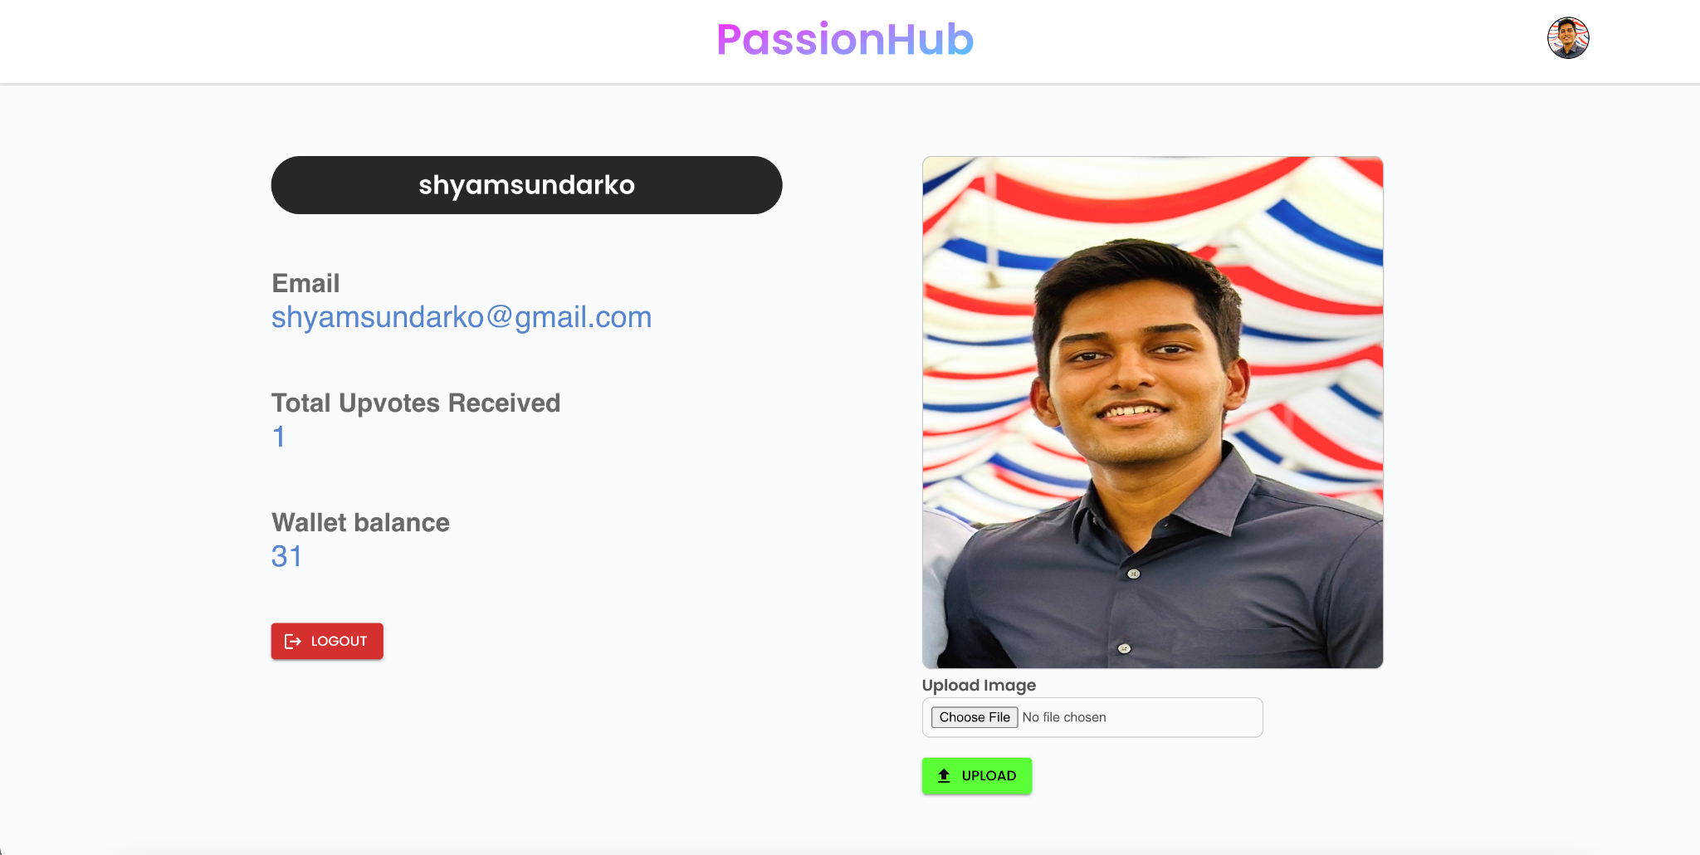
Profile Screen

Slide 14
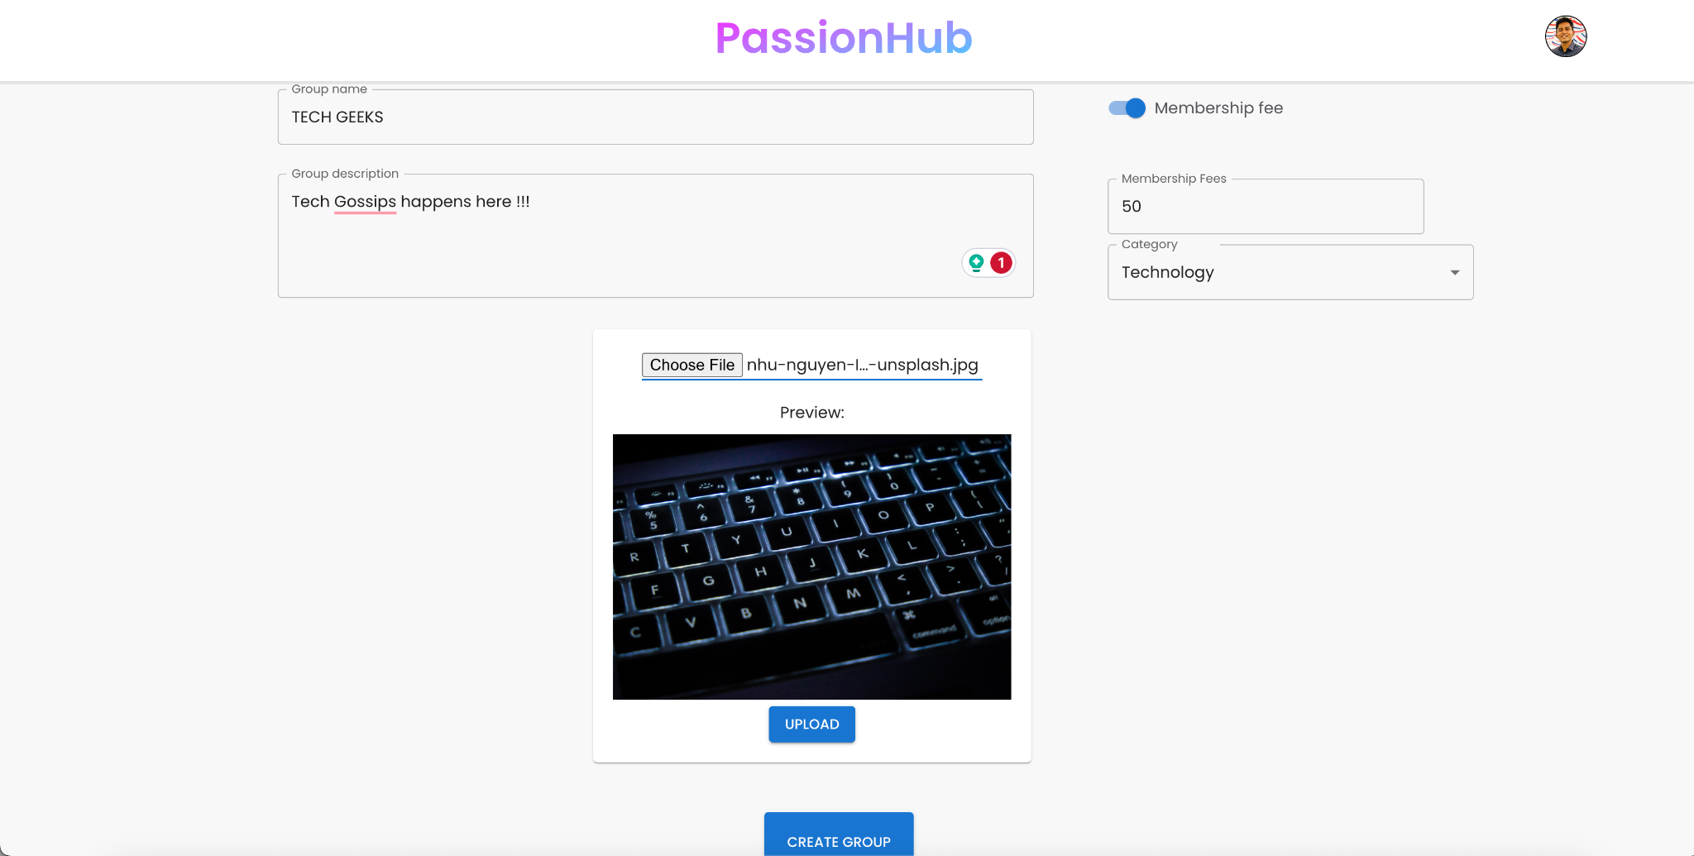
Create Passion Group Screen

Slide 15
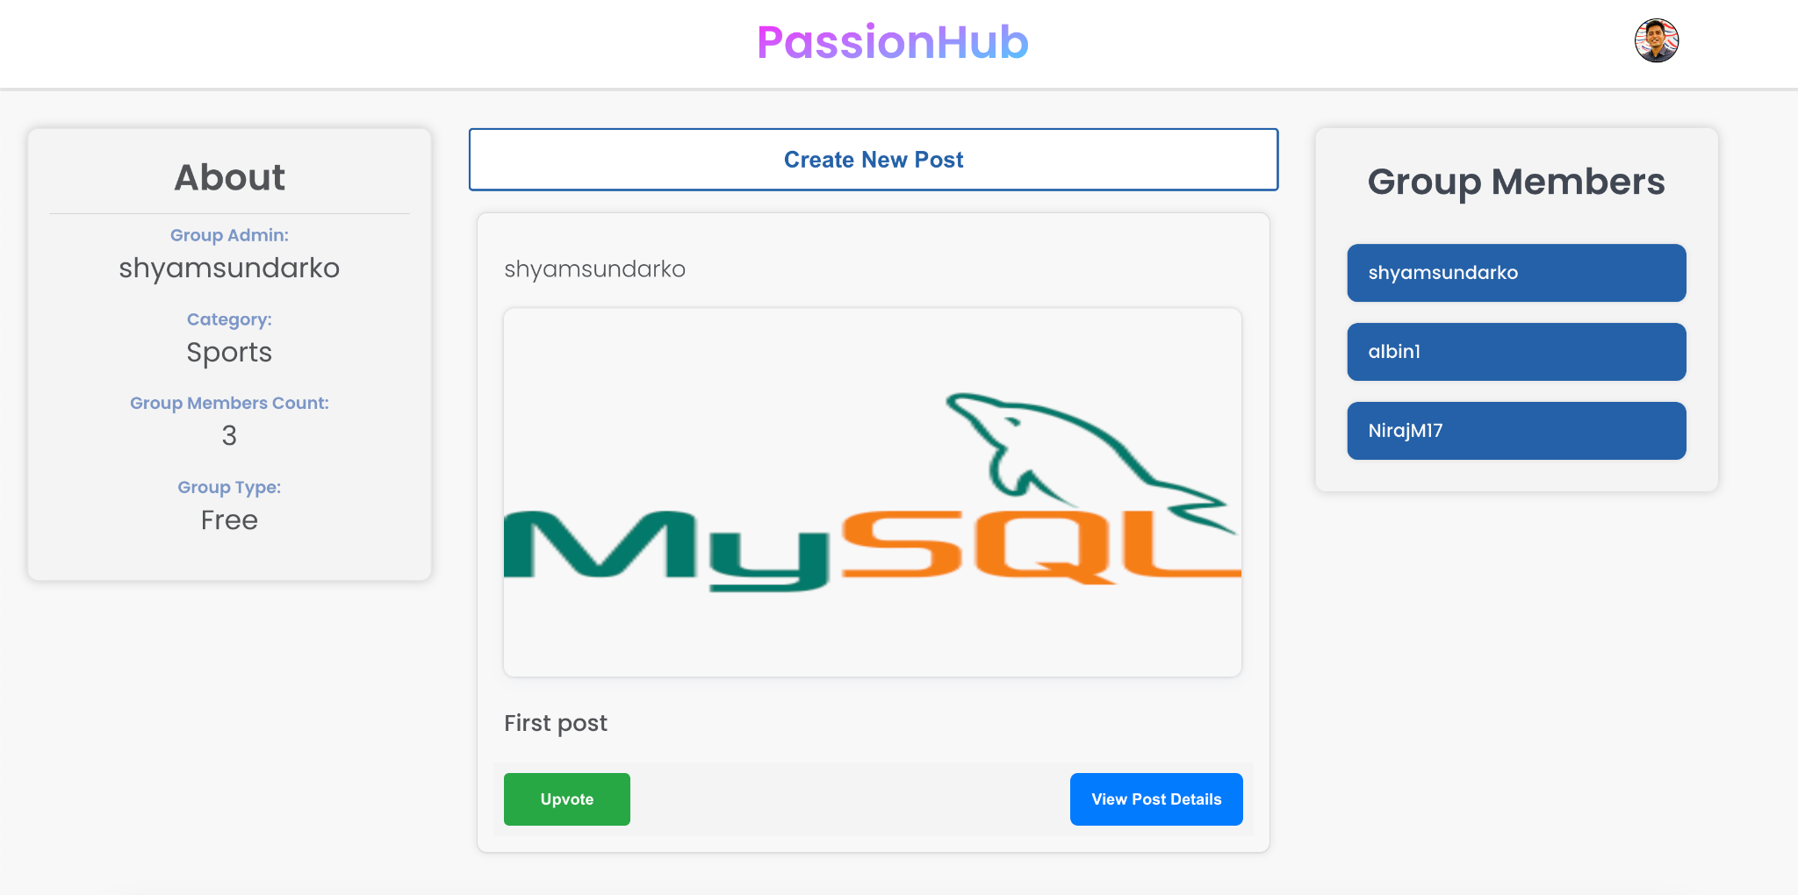
Group Main Screen

Slide 16
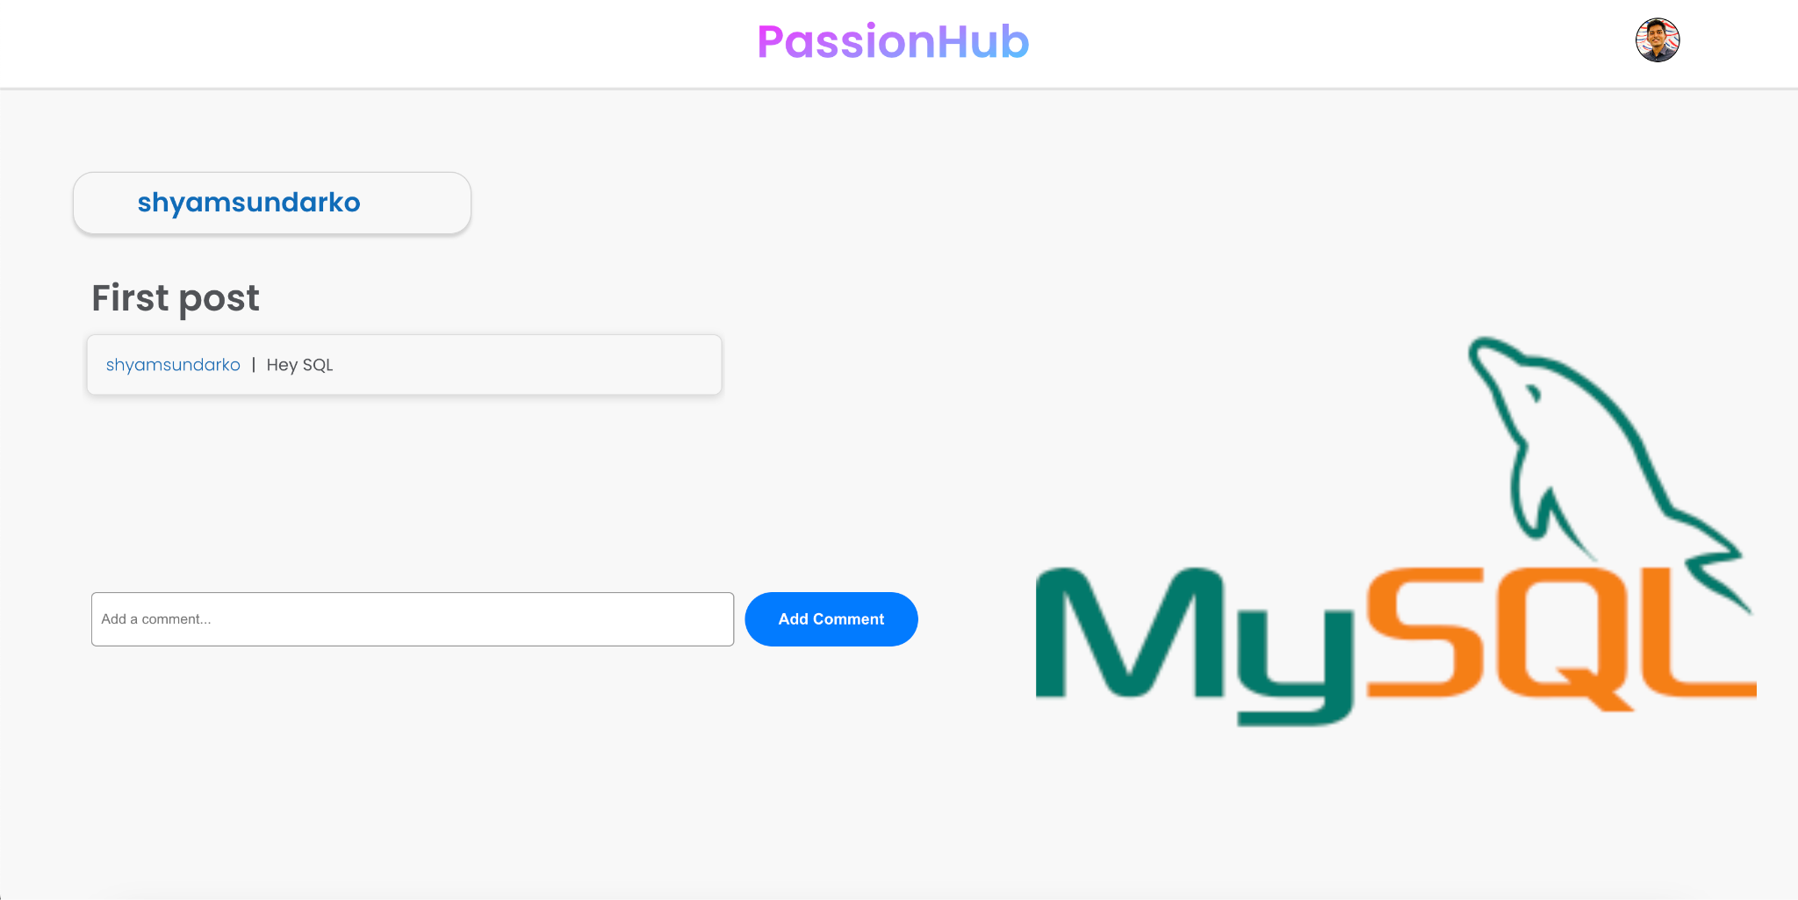
View Post Details Screen

Slide 17
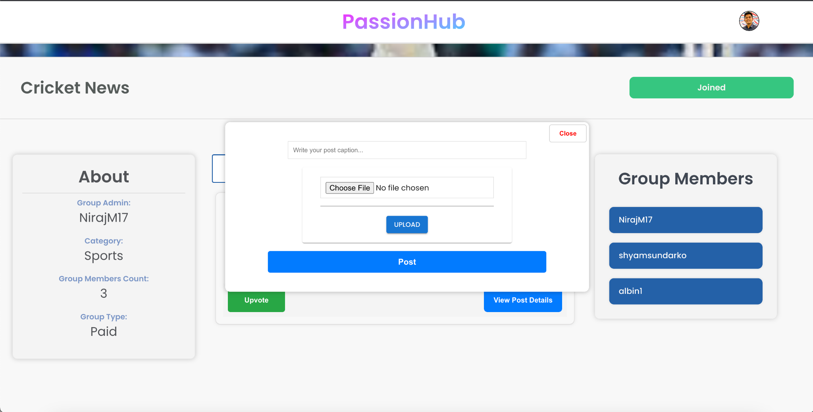
Create Post Modal

Slide 18
Thank you!

